Slide 1
24ADI003-MACHINE LEARNING

Slide 2
Unit III – CLASSIFICATION MODELS
Logistic Regression-Naive Bayes Classifiers-Decision Tree-K-Nearest Neighbors-Support Vector Machine – Evaluation metrices – AUC ROC- Class Imbalance –SMOTE – Cross-Validation Techniques-Ensemble Learning-Bagging- Random Forests-Boosting - AdaBoost -Gradient Boosting

Slide 3
NAIVE BAYES CLASSIFIER
In many real-world problems, we must classify objects:
Is an email Spam or Not Spam?
Will a student Pass or Fail?
Is a transaction Fraud or Genuine?
Naive Bayes solves classification problems by using probability theory.
Instead of guessing directly, it asks:
“Given what I see, which class is most likely?”
Bayes’ Theorem
Bayes’ theorem allows us to reverse conditional probabilities:
$$P\left(C∣X\right)=\frac{P\left(X∣C\right) P\left(C\right)}{P\left(X\right)}$$
Term | Meaning
(P(C)) | Prior probability (how frequent the class is)
(P(X)) | Evidence (same for all classes)
Since $P\left(X\right)$is the same for all classes:
$$P\left(C∣X\right)∝P\left(X∣C\right)P\left(C\right)$$
➡ We do NOT calculate $P\left(X\right)$in practice.

Slide 4
DECISION TREE CLASSIFIERS
Decision Trees mimic human decision making.
Example – Placement Prediction:
So tree = sequence of questions → prediction
Used in:
Medical diagnosis
Loan approval
Fraud detection
Student performance prediction

Slide 5
DECISION TREE CLASSIFIERS
DECISION TREE TERMINOLOGY
Term | Meaning
Root Node | First question
Internal Node | Decision point
Leaf Node | Final output
Branch | Decision outcome
Depth | Length root → leaf
Parent/Child | Node relationship

Slide 6
DECISION TREE CLASSIFIERS
HOW DECISION TREES WORK – STEP-BY-STEP
Calculate impurity of dataset
Try split using each feature
Compute Information Gain
Choose best split
Repeat until pure
Goal → Make nodes pure
Pure node → all samples same class.

Slide 7

DECISION TREE CLASSIFIERS
NODE IMPURITY MEASURES
ENTROPY
Entropy measures uncertainty.
Formula:
$$H\left(S\right)=−\sum{p_{i}}{\log{}}_{2}\left(p_{i}\right)$$
Entropy Values
Lower entropy = better split.
Distribution | Entropy
100% Yes | 0
50% Yes 50% No | 1
80% Yes 20% No | 0.72

Slide 8
DECISION TREE CLASSIFIERS
EXAMPLE
Dataset: – ENTROPY
Step 1 – Probabilities
p(Pass) = 6/10 = 0.6 p(Fail) = 4/10 = 0.4
Step 2 – Logs
log₂(0.6) = −0.737 log₂(0.4) = −1.322
Step 3 – Multiply
−0.6 × (−0.737) = 0.442 −0.4 × (−1.322) = 0.529
Step 4 – Add
Entropy = 0.971
Interpretation → Dataset is mixed.
Pass | Fail
6 | 4

Slide 9
DECISION TREE CLASSIFIERS
EXAMPLE
Dataset: – ENTROPY Entropy = 0.971
INFORMATION GAIN – FULL SOLUTION
Split by Study Hours
Step 1 – Parent Entropy
Already = 0.971
Step 2 – Entropy Low
p = 2/5 = 0.4 Entropy_low = 0.971
Pass | Fail
6 | 4
Group | Pass | Fail
Low | 2 | 3
High | 4 | 1

Slide 10
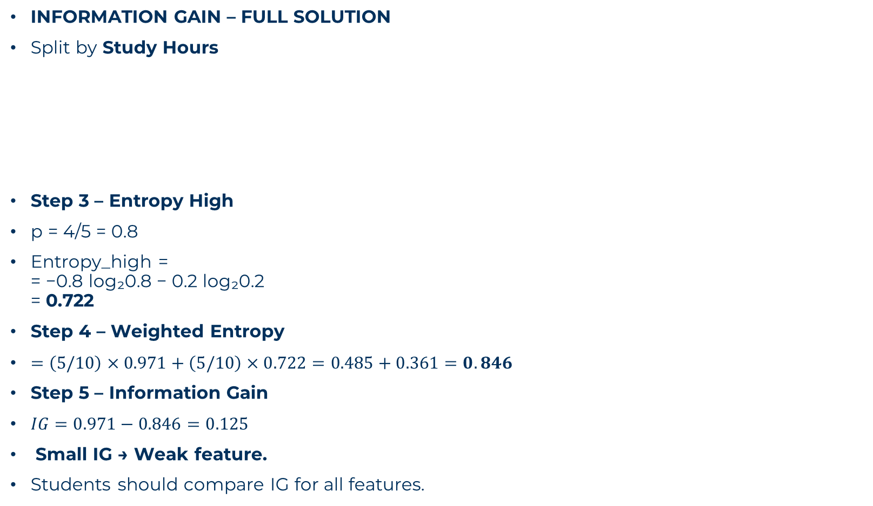
DECISION TREE CLASSIFIERS
INFORMATION GAIN – FULL SOLUTION
Split by Study Hours
Step 3 – Entropy High
p = 4/5 = 0.8
Entropy_high = = −0.8 log₂0.8 − 0.2 log₂0.2 = 0.722
Step 4 – Weighted Entropy
$=\left(5/10\right)×0.971+\left(5/10\right)×0.722=0.485+0.361=0.846$
Step 5 – Information Gain
$IG=0.971−0.846=0.125$
Small IG → Weak feature.
Students should compare IG for all features.
Group | Pass | Fail
Low | 2 | 3
High | 4 | 1

Slide 11

DECISION TREE CLASSIFIERS
GINI INDEX –
Formula:
$$Gini=1−\sum{p_{i}^{2}}$$
Parent:
$$=1−\left({0.6}^{2}+{0.4}^{2}\right)=1−\left(0.36+0.16\right)=0.48$$
Low Hours:
$$=1−\left({0.4}^{2}+{0.6}^{2}\right)=0.48$$
High Hours:
$$=1−\left({0.8}^{2}+{0.2}^{2}\right)=0.32$$
Lower Gini = Better.

Slide 12

DECISION TREE CLASSIFIERS
PROBLEM STATEMENT-Placement Prediction DATASET
Step 1 – Parent Entropy
Yes = 2 No = 3
$$H=−\frac{2}{5}{\log{}}_{2}\frac{2}{5}−\frac{3}{5}{\log{}}_{2}\frac{3}{5}$$
$=0.971$
CGPA>8 | Internship | Placed
Yes | High | Yes
Yes | Medium | Yes
Yes | Low | No
No | High | No
No | Medium | No

Slide 13

DECISION TREE CLASSIFIERS
PROBLEM STATEMENT-Placement Prediction DATASET
Step 2 – Split on CGPA
CGPA=Yes → 2 Yes,1 No CGPA=No → 0 Yes,2 No
Entropy(CGPA Yes):
$$=−\frac{2}{3}{\log{}}_{2}\frac{2}{3}−\frac{1}{3}{\log{}}_{2}\frac{1}{3}=0.918$$
Entropy(CGPA No) = 0
Weighted entropy:
$$=\frac{3}{5}×0.918+\frac{2}{5}×0=0.551$$
IG(CGPA) = 0.971 − 0.551 = 0.42
CGPA>8 | Internship | Placed
Yes | High | Yes
Yes | Medium | Yes
Yes | Low | No
No | High | No
No | Medium | No

Slide 14
DECISION TREE CLASSIFIERS
PROBLEM STATEMENT-Placement Prediction DATASET
Step 3 – Split on Internship
Compute similarly → IG smaller.
So CGPA is best root.

Slide 15
DECISION TREE CLASSIFIERS
OVERFITTING & PRUNING IN DECISION TREES
Overfitting happens when a model learns the training data too perfectly, including noise and random patterns.
So it performs:
Very high accuracy on training data Poor accuracy on new/test data
The model memorizes instead of learning.
Suppose student placement data has 100 students.
Model Result:
This means the tree memorized special cases like:
IF CGPA>8 AND Internship=Yes AND Name=Ravi → Placed
Using Name is meaningless → Overfitting.
Dataset | Accuracy
Training | 100%
Test | 55%

Slide 16
DECISION TREE CLASSIFIERS
OVERFITTING & PRUNING IN
DECISION TREES

Slide 17
DECISION TREE CLASSIFIERS
OVERFITTING & PRUNING IN DECISION TREES
WHY OVERFITTING HAPPENS IN DECISION TREES
Decision Trees keep splitting until nodes are pure.
This can create:
Very deep trees
Too many branches
Splits based on noise
Causes
Small dataset
Too many features
No pruning
Outliers
Imbalanced data
EFFECTS OF OVERFITTING
Poor prediction on new data
High variance model
Complex tree hard to interpret
Wasted computation

Slide 18
DECISION TREE CLASSIFIERS
OVERFITTING & PRUNING IN DECISION TREES
SOLUTIONS TO OVERFITTING
1. LIMIT TREE DEPTH
Depth
Depth = number of levels from root to leaf.
Example:
Depth 1 → Only 1 split Depth 10 → Many splits
Why Limit Depth?
Deep tree learns noise.
So we stop tree early.
Example
Dataset of 50 students.
Depth=1 accuracy → 70% Depth=5 accuracy → 85% Depth=20 accuracy → 100% training but 60% test
Best depth ≈ 5
Limiting depth reduces overfitting Makes tree simple & interpretable

Slide 19
DECISION TREE CLASSIFIERS
OVERFITTING & PRUNING IN DECISION TREES
SOLUTIONS TO OVERFITTING
2. MINIMUM SAMPLES PER LEAF
A leaf node should have enough data.
If leaf has only 1 sample → memorization.
Example
If tree splits until each leaf has 1 student:
IF RollNo=24BAD042 → Pass
Not useful.
Solution
Set minimum samples.
Example:
min_samples_leaf = 5
Means each leaf must have at least 5 records.
Effect
Reduces noise Smooth predictions Better generalization
EXAMPLE
Dataset = 100 students.
Without rule → 100 leaves With min_samples_leaf=10 → only 10 leaves
Tree becomes stable.

Slide 20
DECISION TREE CLASSIFIERS
OVERFITTING & PRUNING IN DECISION TREES
SOLUTIONS TO OVERFITTING
3. PRUNING
Pruning = Cutting unnecessary branches.
Types of Pruning
1. Pre-Pruning (Early Stopping)
Stop tree before it becomes too deep.
Conditions:
max_depth
min_samples_split
min_samples_leaf
min_information_gain
Example
Stop splitting if IG < 0.01
Ignore weak splits.
2.Post-Pruning (Reduced Error Pruning)
Build full tree first → then remove branches that don’t improve accuracy.
Steps:
Build full tree
Check each branch
Remove if accuracy doesn’t drop
Example
Before pruning:
CGPA>8?
AND Internship=Yes?
AND Library>3?
After pruning:
CGPA>8?
AND Internship=Yes?
Simpler and better.
Cost-Complexity Pruning (CART)
Minimize:
Error + α × Tree Size
Balances accuracy & simplicity.

Slide 21
DECISION TREE CLASSIFIERS
OVERFITTING & PRUNING IN DECISION TREES
SOLUTIONS TO OVERFITTING
4. CROSS-VALIDATION
Cross-validation tests model on multiple splits.
Common method → k-fold cross-validation
Steps
Split data into k parts
Train on k-1 parts
Test on remaining part
Repeat k times
Take average accuracy
Example (k=5)
Data = 100 students
Each fold = 20 students.
Accuracy results:
70%, 72%, 75%, 71%, 74%
Average = 72.4%
Choose model with best average accuracy.
Why Useful?
Detect overfitting Choose best depth Choose best parameters
EXAMPLE:
College predicts pass/fail.
Tree depth 15 → 100% training accuracy Test accuracy 58%
After pruning depth=4:
Training accuracy 88% Test accuracy 84%
Better generalization.

Slide 22
K-NEAREST NEIGHBORS (KNN)
KNN works like human reasoning.
“People similar to you behave like you.”
Example – Student prediction:
If most nearby students passed → You will pass.
So prediction depends on neighbors.
Why called Lazy Learner?
Because KNN:
Does no training Stores all data Predicts only when test data comes
So memory heavy but simple.
Real-Life Examples
Movie recommendation
Image recognition
Spam detection
Medical diagnosis
Student performance prediction

Slide 23
K-NEAREST NEIGHBORS (KNN)
KNN – STEP BY STEP
Suppose we want to predict Pass/Fail.
Steps:
Choose K (number of neighbors)
Measure distance from test point to all training points
Pick K nearest points
Majority vote
That class becomes prediction.

Slide 24
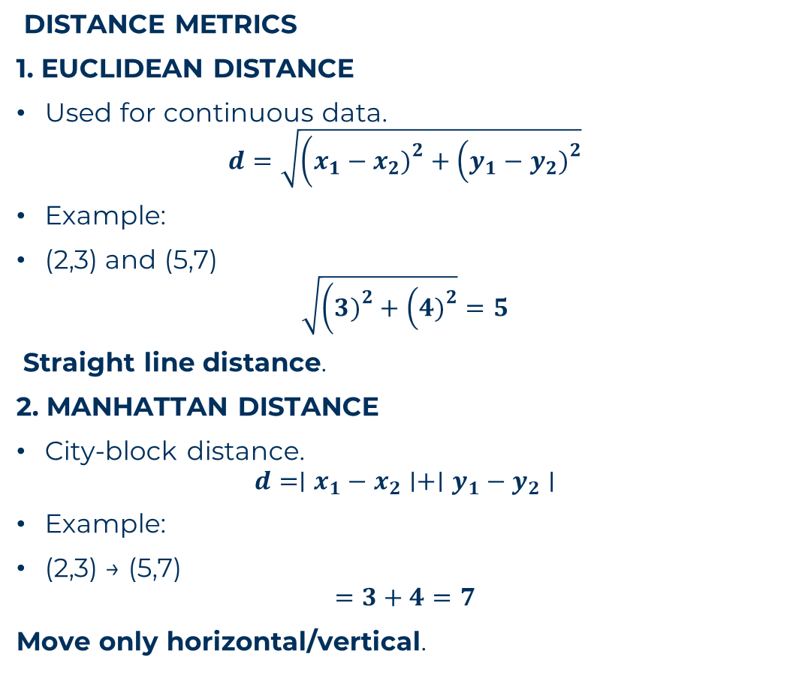
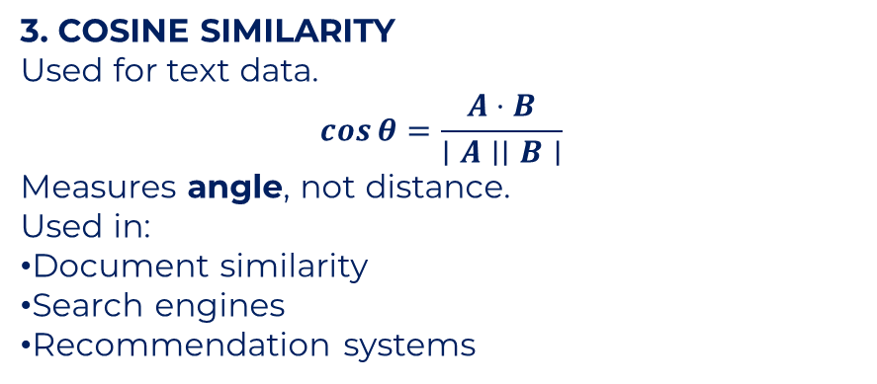
K-NEAREST NEIGHBORS (KNN)
DISTANCE METRICS
1. EUCLIDEAN DISTANCE
Used for continuous data.
$$d=\sqrt{\left(x_{1}−x_{2}{\left.)\right.}^{2}+\left(y_{1}−y_{2}{\left.)\right.}^{2}\right.\right.}$$
Example:
(2,3) and (5,7)
$$\sqrt{\left(3{\left.)\right.}^{2}+\left(4{\left.)\right.}^{2}\right.\right.}=5$$
Straight line distance.
2. MANHATTAN DISTANCE
City-block distance.
$$d=∣x_{1}−x_{2}∣+∣y_{1}−y_{2}∣$$
Example:
(2,3) → (5,7)
$$=3+4=7$$
Move only horizontal/vertical.
3. COSINE SIMILARITY
Used for text data.
$$\cos{θ}=\frac{A⋅B}{∣A∣∣B∣}$$
Measures angle, not distance.
Used in:
Document similarity
Search engines
Recommendation systems

Slide 25
K-NEAREST NEIGHBORS (KNN)
PROBLEM STATEMENT KNN
Training Data
Test Student = (60,70) K = 3
Math | Physics | Result
40 | 50 | Fail
45 | 60 | Fail
70 | 80 | Pass
80 | 90 | Pass

Slide 26

K-NEAREST NEIGHBORS (KNN)
PROBLEM STATEMENT KNN
Training Data
Test Student = (60,70) K = 3
Step 1 – Distance Calculation
Distance to (40,50)
$$\sqrt{\left(60−40{\left.)\right.}^{2}+\left(70−50{\left.)\right.}^{2}\right.\right.}$$
$$=\sqrt{{20}^{2}+{20}^{2}}=\sqrt{800}=28.28$$
Distance to (45,60)
$$\sqrt{{15}^{2}+{10}^{2}}=\sqrt{325}=18.03$$
Distance to (70,80)
$$\sqrt{{10}^{2}+{10}^{2}}=\sqrt{200}=14.14$$
Distance to (80,90)
$$\sqrt{{20}^{2}+{20}^{2}}=28.28$$
Math | Physics | Result
40 | 50 | Fail
45 | 60 | Fail
70 | 80 | Pass
80 | 90 | Pass

Slide 27
K-NEAREST NEIGHBORS (KNN)
PROBLEM STATEMENT KNN
Training Data
Test Student = (60,70) K = 3
Nearest 3 → Pass, Fail, Fail
Math | Physics | Result
40 | 50 | Fail
45 | 60 | Fail
70 | 80 | Pass
80 | 90 | Pass
Step 2 – Sort Distances
Distance | Result
14.14 | Pass
18.03 | Fail
28.28 | Fail
28.28 | Pass

Slide 28
K-NEAREST NEIGHBORS (KNN)
PROBLEM STATEMENT KNN
Step 3 – Majority Vote
Fail = 2 Pass = 1
Prediction → FAIL
Interpretation
Student performance similar to failing students.
So predicted Fail.
Distance | Result
14.14 | Pass
18.03 | Fail
28.28 | Fail
28.28 | Pass
Step 2 – Sort Distances

Slide 29
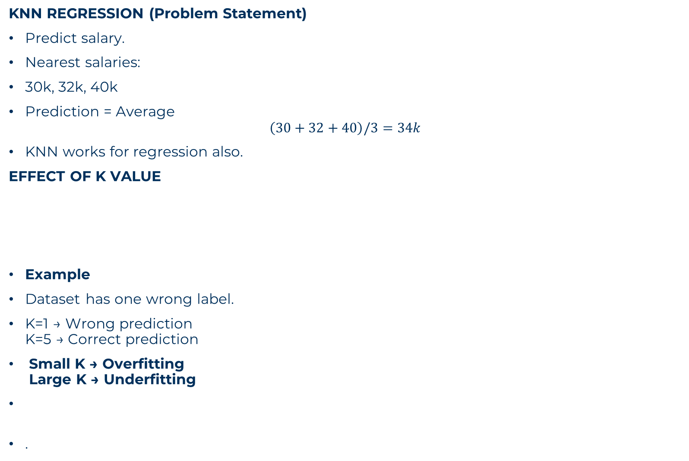
K-NEAREST NEIGHBORS (KNN)
KNN REGRESSION (Problem Statement)
Predict salary.
Nearest salaries:
30k, 32k, 40k
Prediction = Average
$$\left(30+32+40\right)/3=34k$$
KNN works for regression also.
EFFECT OF K VALUE
Example
Dataset has one wrong label.
K=1 → Wrong prediction K=5 → Correct prediction
Small K → Overfitting Large K → Underfitting
.
K Value | Result
Small K | Sensitive to noise
Large K | Too smooth
Best K Selection
Use Cross-Validation.
Try K=1 to 20 → Choose best accuracy

Slide 30

K-NEAREST NEIGHBORS (KNN)
NORMALIZATION IN KNN
Very important!
Because KNN uses distance.
If one feature has large scale → dominates.
Example
Height dominates distance.
Solution
Min-Max Scaling
$$x^{′}=\frac{x−min}{max−min}$$
Standardization
$$z=\frac{x−μ}{σ}$$
Makes features comparable.
Feature | Value
Height | 170
Marks | 80

Slide 31

K-NEAREST NEIGHBORS (KNN)
PROBLEM STATEMENT
Points:
(2,3) A (3,4) A (7,8) B (8,9) B
Test = (4,5), k=3
Step 1 – Distances
To (2,3)
$$\sqrt{\left(2{\left.)\right.}^{2}+\left(2{\left.)\right.}^{2}\right.\right.}=2.82$$
To (3,4)
$$\sqrt{1^{2}+1^{2}}=1.41$$
To (7,8)
$$\sqrt{3^{2}+3^{2}}=4.24$$
To (8,9)
$$\sqrt{4^{2}+4^{2}}=5.65$$
Step 2 – Sort
1.41 → A 2.82 → A 4.24 → B
Step 3 – Majority
A = 2 B = 1
Prediction → A

Slide 32
K-NEAREST NEIGHBORS (KNN)
ADVANCED KNN IDEAS
Weighted KNN
Closer neighbors get more importance.
Weight = 1 / distance.
Example:
Distance 1 → Weight 1 Distance 5 → Weight 0.2
More accurate prediction.
KD-Tree & Ball Tree
Used to speed up KNN search.
Important for big data.
Curse of Dimensionality
Too many features → distances become meaningless.
Example:
100 features → all points equally far.
Solution:
PCA
Feature selection
Remove irrelevant features

Slide 33
K-NEAREST NEIGHBORS (KNN)
KNN VS DECISION TREE
Feature | Decision Tree | KNN
Training | Fast | None
Prediction | Fast | Slow
Memory | Low | High
Interpretability | High | Low
Scaling Needed | No | Yes

